Slide 1
Fatigue Tests and Metallographic of Explosively Cladded Steel-Titanium Bimetal
Adam NIESŁONY¹, Andrzej KUREK¹, Marcin WACHOWSKI², Tomasz PŁOCIŃSKI², Krzysztof Jan KURZYDŁOWSKI²
¹Opole University of Technology, Opole, POLAND
²Warsaw University of Technology, Warsaw, POLAND
XII International Symposium
on Explosive Production of New Materials:
Science, Technology, Business, and Innovations
(EPNM-2014)

Slide 2
Content
1. Introduction
2. Experiments:
Cyclic bending
Three-point bending
3. Conclusion and acknowledgements

Slide 3
Explosive cladding/welding
Explosion welding allows a permanent connecting of the applied material (sheets, tubes, strips, foils) with a metallic substrate (plate, forgings, rods, tubes, etc.) using the energy of the explosion.
It is mainly used for materials which are difficult to connect or can not be connected with other methods in some areas while remaining competitive method to the other.

Slide 4
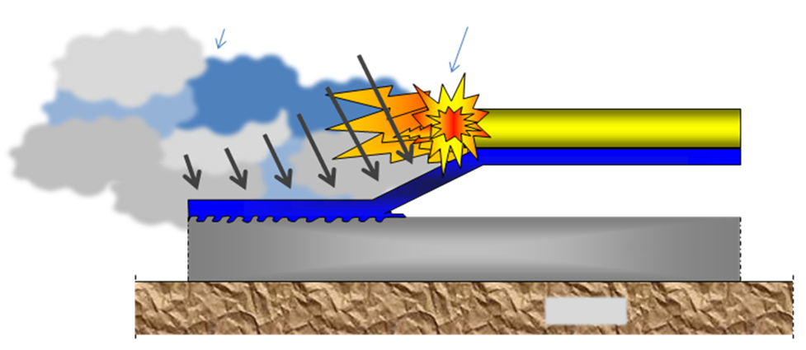
Explosive cladding/welding
fumes
front of explosion
forces direction
explosives
Imposed material
technological gap
base material
ground

Slide 5
The structure of steel-titanium connector
Bimetallic arrangement
Tytan Gr.1
Carbon steel
Resulting from a collisions of the surfaces, a wavy interface is formed

Slide 6
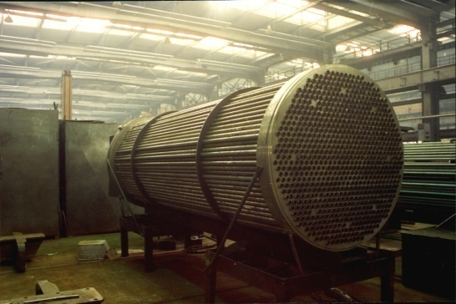
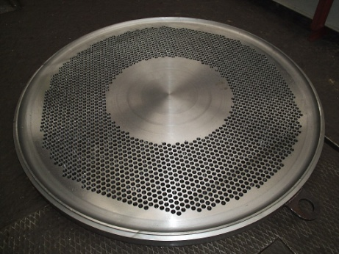
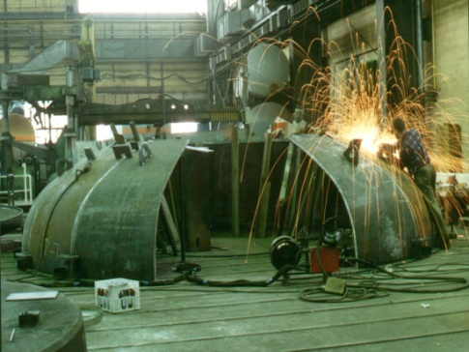
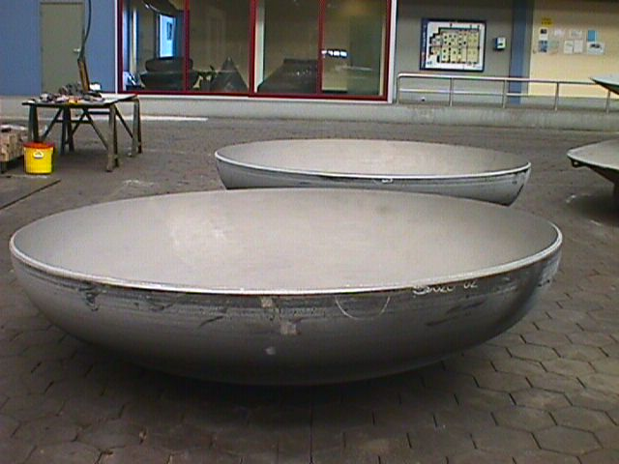
Examples of application
in the construction of process equipment:
end cap
tubesheets
coats

Slide 7
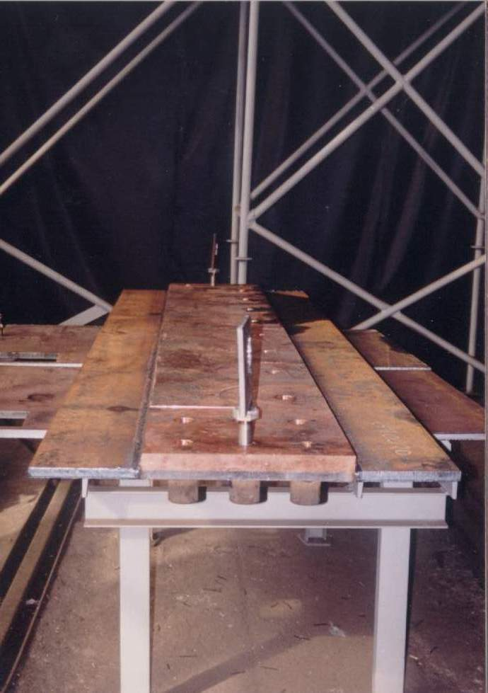
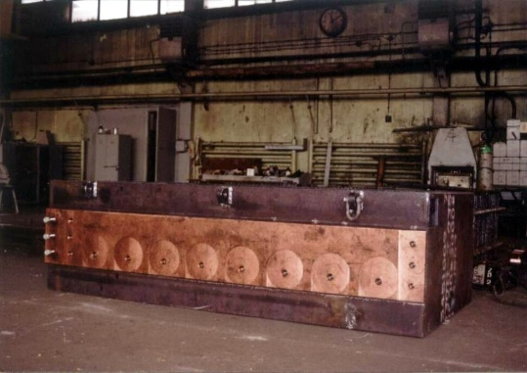
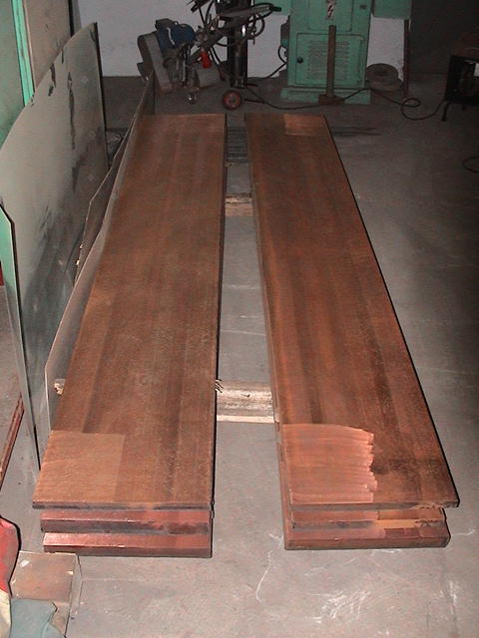
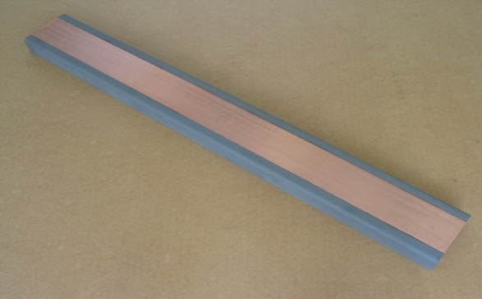
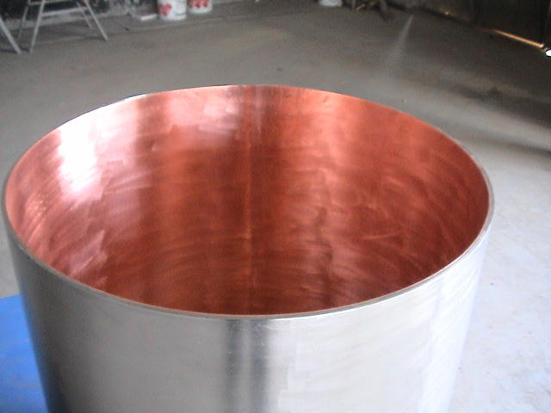
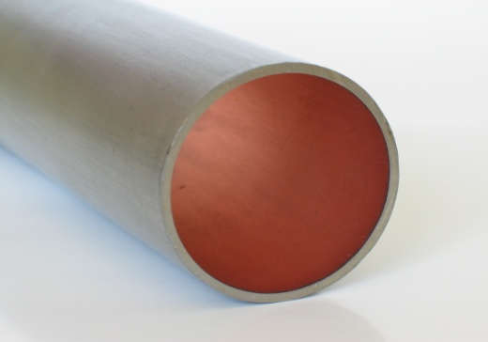
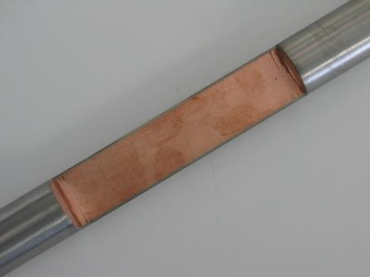
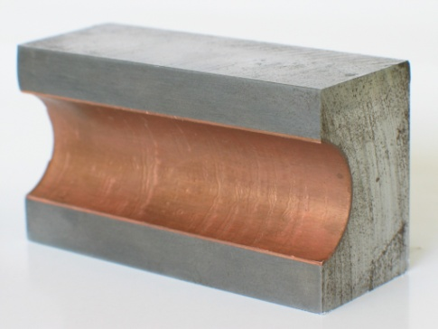
Examples of application
electrochemistry
electroenergetics
electrometallurgy
others

Slide 8
Fatigue life experiments – Cyclic bending
This paper presents results of the fatigue tests of the bimetallic material being a joint of steel S355J2+N with titanium SB265G1 under pendulum bending for two different bending configurations (perpendicular and parallel) and under three-point bending.
Fatigue life characteristics of bimetal and native materials (titanium and steel under pendulum bending) were obtained.
Thickness of the overlaid material (titanium) was 6 mm, so the specimens of untypical, determined with FEM, shape and dimensions were used for fatigue tests.

Slide 9
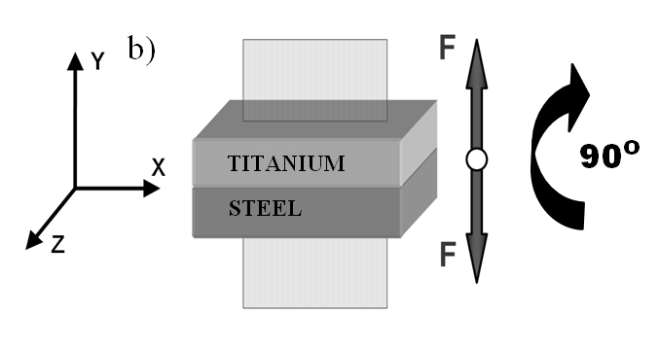
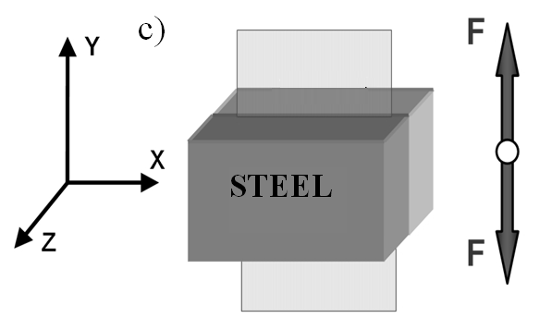
a)
micro-section
9
Mg
Crack
7
100
c)
Scheme of attachment and loading of specimens (a) and a scheme of the loading method depending on the specimen attachment: perpendicular (b) or in parallel (c)

Slide 10
Fatigue life characteristics
Graph presenting dependence of the stress amplitude σ_{a}=f(N_{f}) in titanium

Slide 11
Fatigue life characteristics
Graph presenting dependence of the stress amplitude σ_{a}=f(N_{f}) in titanium and steel

Slide 12
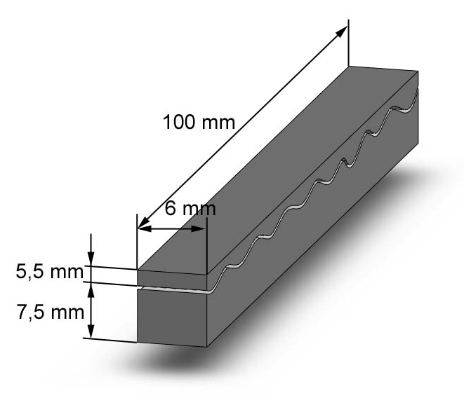
Three-point bending
Next investigations were also performed on the bimetal S355J2 explosively welded (cladded) with titanium Grade 1. To investigate fatigue strength of the bimetal, three-points bending test were carried out. Specimens to be tested were cut from the bimetal in parallel direction relative to joining direction, from central part of plates. In order to avoid the effect of concentration of the shearing stresses specimens edges were rounded additionally.
Dimensions of specimen used in three-points bending

Slide 13
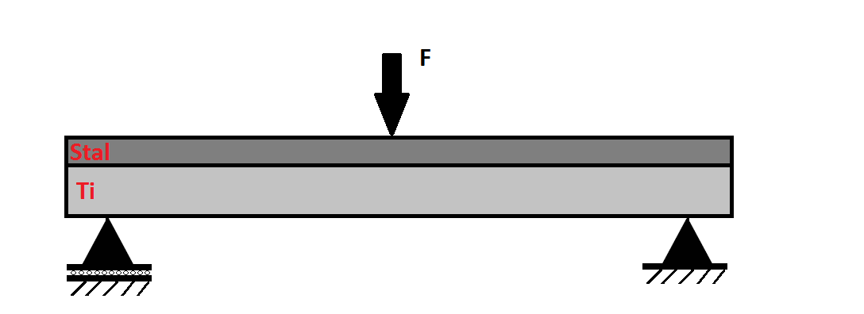
Experimental results
Force, kN | S355J2+SB265G1
 | Number of cycles to failure, N_{f}
 | specimen 1 | specimen 2 | specimen 3 | average
4 | 4000000 | - | - | 4000000
5 | 15000000 | - | - | 15000000
6 | 4000000 | 3149399 | 4000000 | 3716466
7 | 566599 | 436799 | 271399 | 424932
8 | 356599 | 230599 | 205799 | 264332
9 | 93799 | 87599 | 96799 | 92732
10 | 51399 | 44599 | 64599 | 53532
Schemat obciążenia próbek

Slide 14
Three-point bending
before heat treatment
after heat treatment
Notes:
Investigations were carried out on the specimens in state before and after the heat treatment. Applied annealing was performed in temperature 600°C for 90 min with cooling in furnace to 300°C and in air to environment conditions. The heat treatment conditions were matched in cooperation with Explomet company, were investigated bimetal was produced as well.

Slide 15
Materials and research methodology
In order to define three-points bending test results, series of research methods were used. These methods were:
Metallographic observations of the bimetal;
Scanning electron microscope observations of fractures resulted from the bending test;
Microhardness measurements.

Slide 16
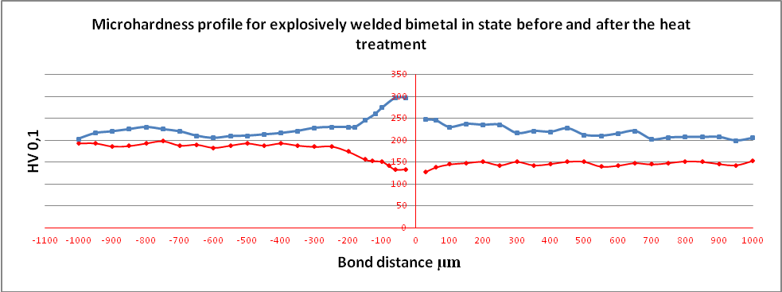
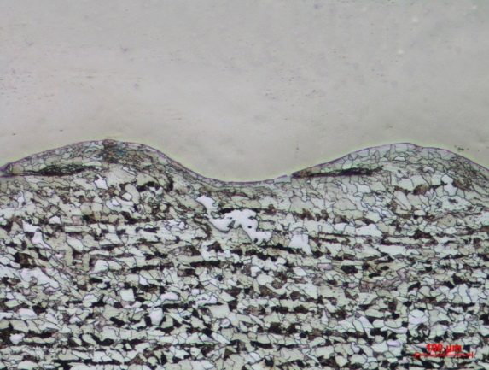
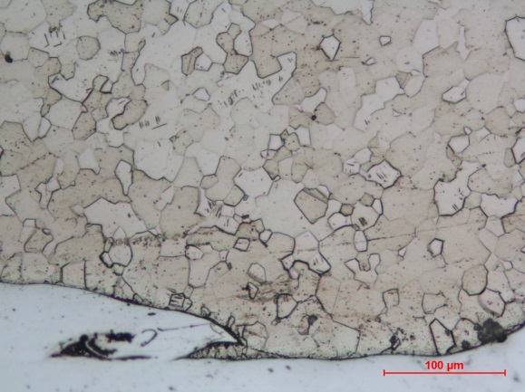
Material structure
STEEL
TITANIUM
before heat treatment
after heat treatment
Microhardness profile for explosively welded bimetal in state before and after the heat treatment
Decarbonization area
TITANIUM
STEEL
Microstructure of explosively welded bimetal.
Specimens after the heat treatment
Notes:
Microhardness test results plotted as a graph in Fig. 11 revealed significant reduction of microhardness near the bond area, particularly at the steel side. Lower microhardness in the bond area in comparison to the greater distance is associated with decarbonization of steel observed in area adjacent to interface on width 150 µm. Phenomenon of decarbonization was a result of performed the heat treatment. Moreover, applied annealing contributed to stress relaxation what is associated with significant changes in microstructure like removing the grains deformation.
Results showed in Fig. 12. revealed that cracks propagations were always initiated on the sides of the specimens, despite the fact that the edges of all specimens were rounded. It was

Slide 17
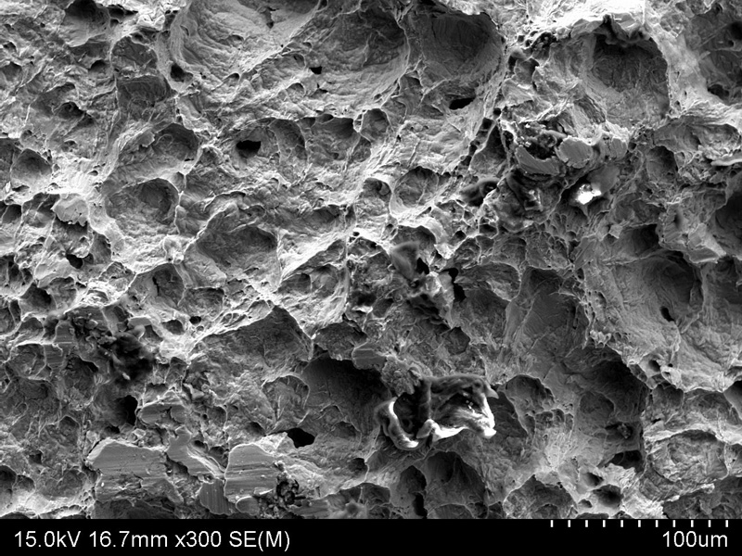
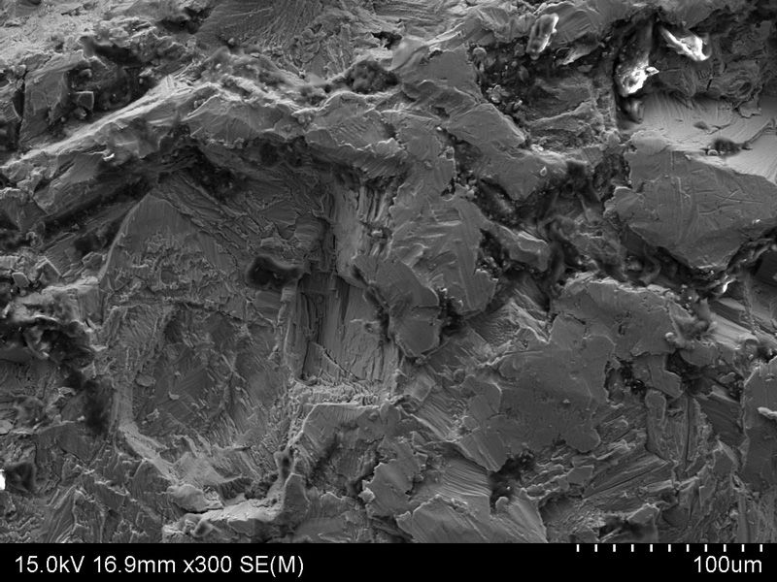
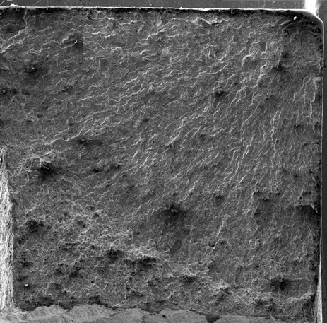
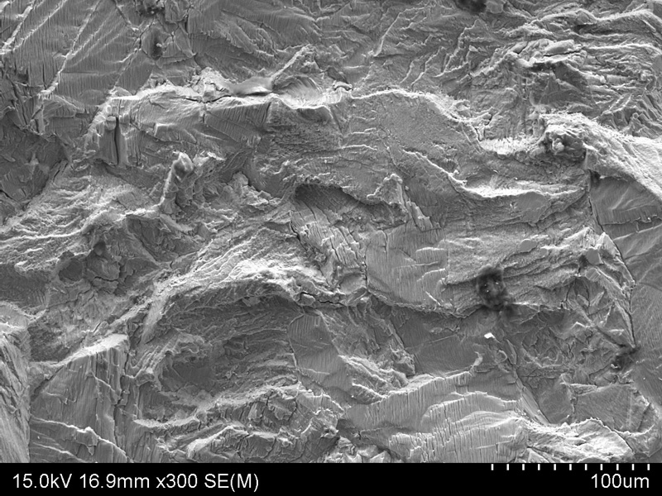
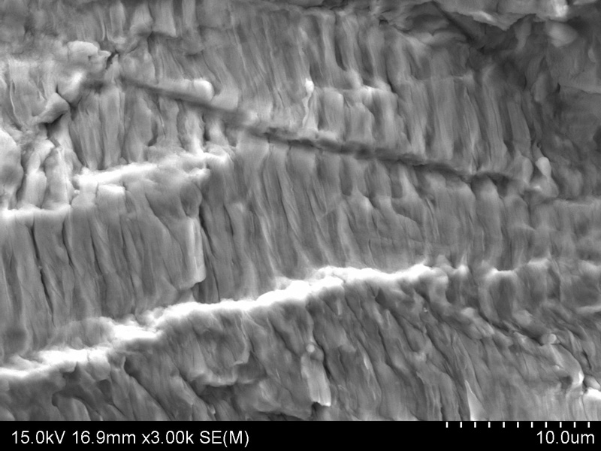
Fracture of the specimen after the three-points bending test
1
2
2
4
3
3
4
1
Notes:
also observed that the area of the crack initiation was characterized for plastic fracture. Detailed observations revealed presence of microcracks in that area, with were connected with each other and propagated further as a main crack.

Slide 18
Conclusion and acknowledgements
From the tests it appears that titanium SB265 G1 was very often the material in which the crack initiation occurs. This occurs in bimetallic specimens loaded on the plane perpendicular to the joint. In spite of great difference in Young modulus of the joined materials, determining a lower stress value, titanium has a lower fatigue life.
On the other hand, in the case of specimens subjected to bending on the plane parallel to the joint plane, the crack initiation occurred in the steel layer of the bimetal. Thus, we can state that for a given specimen shape, loading by alternating bending and the resulting stress distribution, the fatigue life of both materials is similar, and the final life is influenced by different random factors caused by technology of materials joining (inclusions, heterogeneity of the joining cone etc.). Thus, while designing of machine elements made of bimetals a designer should use fatigue characteristics including fatigue properties of the basic material and the overlaid material.

Slide 19
Conclusion and acknowledgements
If the tested specimens are loaded in parallel to the joint plane, the difference of stress amplitude occurring in steel and titanium is greater, so the crack initiation process will proceed in the steel layer at first.
From the tests it also appears that the fatigue life of the specimens made of the native material obtained from the clad is lower than the fatigue life of steel-titanium specimens.
Fatigue tests of bimetallic and titanium specimens show no significant difference in fatigue life of titanium SB265G1 before and after cladding and heat treatment.
Basing on the results from three-points bending test in relation to microstructural and microhardness measurements it may be concluded that fatigue strength of bimetal S355J2+ Ti Grade 1 obtained by explosive welding method is related with heat threatment.

Slide 20
Thank you
XII International Symposium
on Explosive Production of New Materials:
Science, Technology, Business, and Innovations
(EPNM-2014)

